Slide 1

Deep Learning-Based Promoter Prediction for Oncogene Targeting in Cancer Therapy
Team 14
Donia Sameh Farouk 20P3424
Seif Eldin Amr Mostafa 20P2006
To Dr. Ashraf Abdelraouf

Slide 2



CONTENTS
Introduction
Project Objective
Our Solution
Results & Analysis
Conclusion
Future Work

Slide 3
Introduction

Slide 4
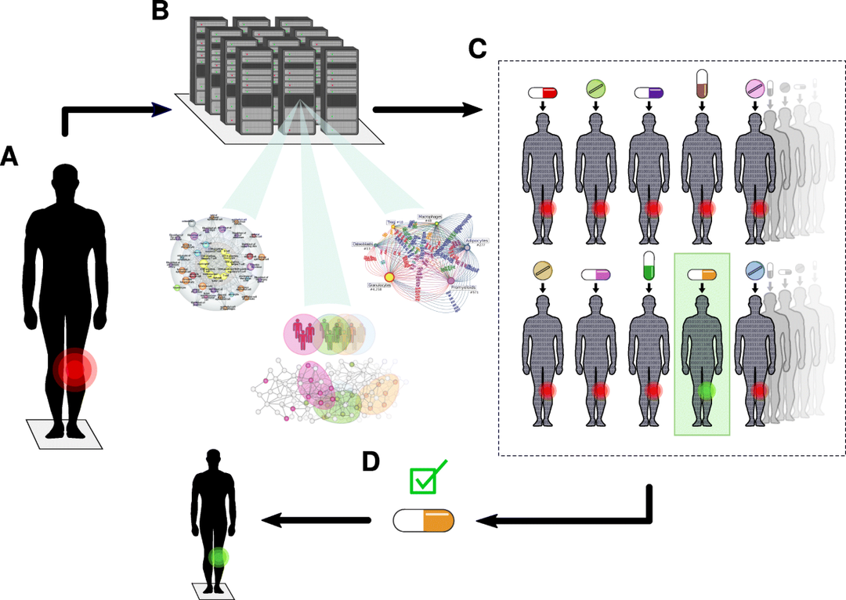
Digital Twins for Personalized Medicine
A Digital Twin is a virtual replica of a biological system.
In our project, the model simulates promoter activity and gene expression response.

Slide 5
Digital Twins for Personalized Medicine
We create a digital simulation of gene regulation and predict CRISPR response.
This enables precision targeting and virtual testing before real-world trials.
Lays the foundation for AI-guided cancer therapy personalization.

Slide 6
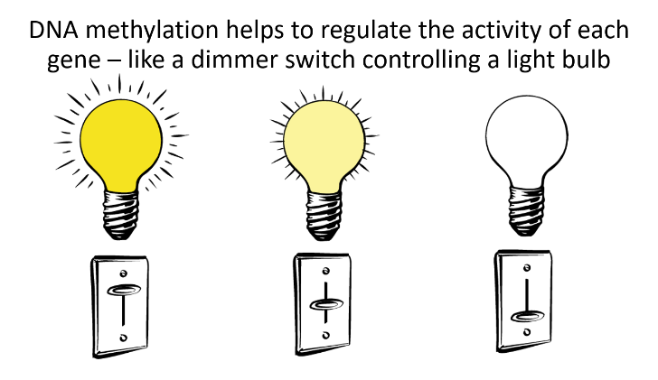
The Challenge in Cancer Treatment
“Cancer often begins when the wrong genes are switched ON — at the wrong place and time.”
Our mission: detect the switches (promoters) before things go wrong.
Gene Activation Matters
Our Genes = Thousands of Instructions
Some should be ON (doing their job)
Some should stay OFF (silent watchers)
Promoters control that switch

Slide 7
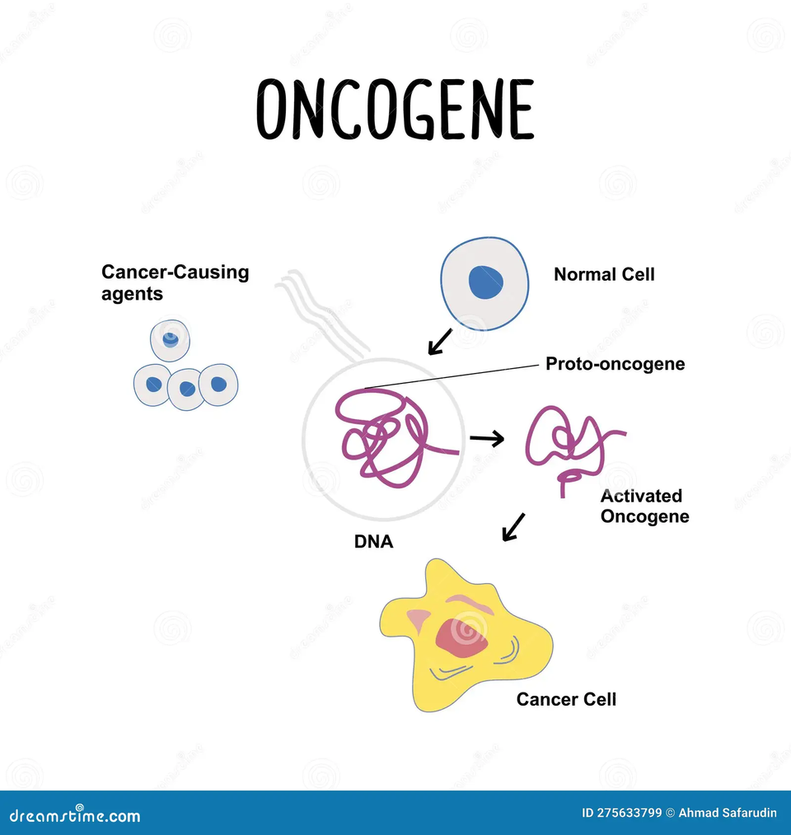
The Challenge in Cancer Treatment
Oncogene Activation
Oncogenes are normal genes that become harmful when overactivated.
Mutation or epigenetic activation (like promoter overactivity) can cause uncontrolled cell growth.
Challenge: It’s hard to predict which oncogenes are activated and when — that's where your project helps.

Slide 8
The Challenge in Cancer Treatment
Tumor Suppressor Gene Silencing:
These genes stop cancer — but they can get turned OFF through mutation or promoter suppression.
Challenge: Silencing these is like cutting the brakes of a car. But it’s often invisible until too late.

Slide 9
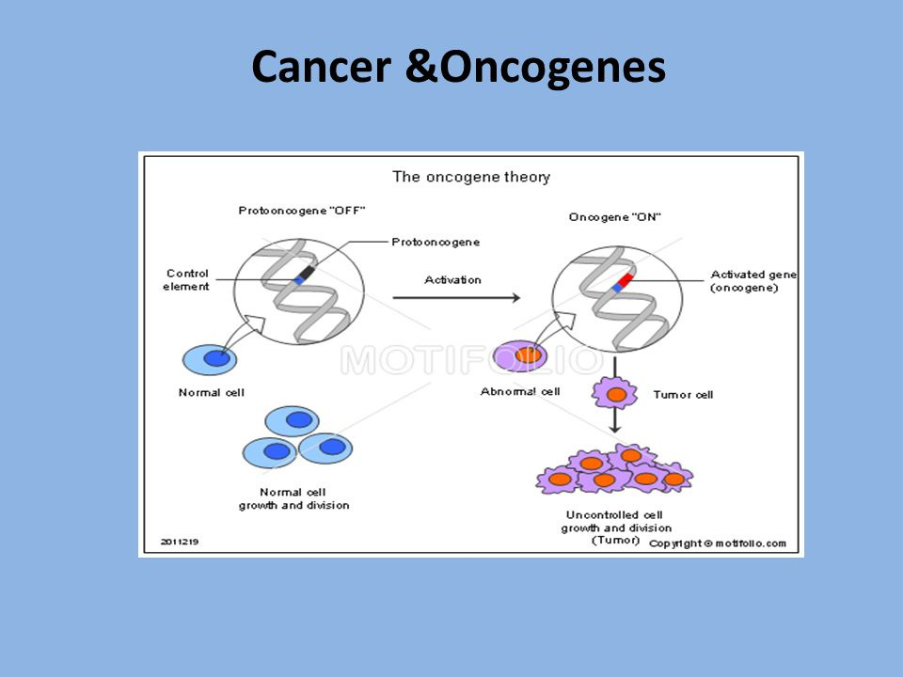
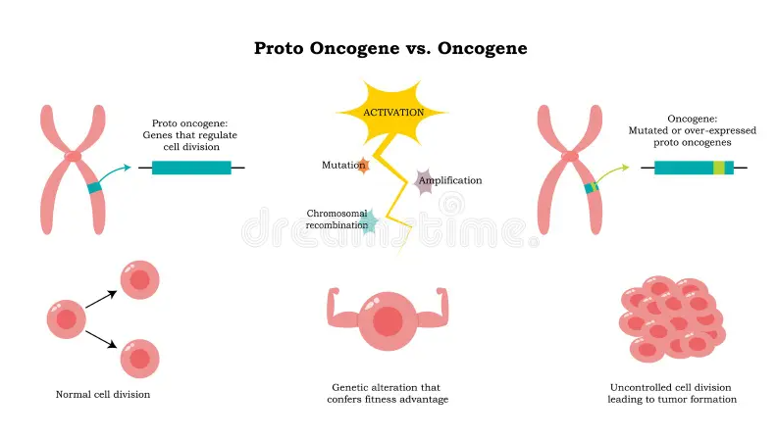
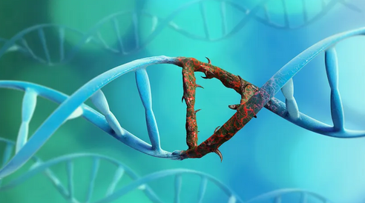
Cancer & Oncogenes
These genes can be misregulated due to abnormal promoter activity.
Identifying which promoters are active can help detect cancer early and guide treatment
In Cancer, These Switches Go Wrong
In cancer, some promoters may activate bad genes at the wrong time.
This can cause cells to grow uncontrollably.
Hard to Find Promoters Manually
Promoters are small and hidden within long DNA strands.
Searching for them by hand is slow and complex
We need smart AI tools to automatically scan DNA and find these dangerous promoter regions near cancer genes.

Slide 10
Project Objective

Slide 11



Match them to known oncogenes using COSMIC.
Validate oncogene expression with TCGA/GTEx data.
Predict promoter regions in DNA sequences.
Simulate CRISPR silencing for upstream promoters.

Slide 12
Our Solution

Slide 13

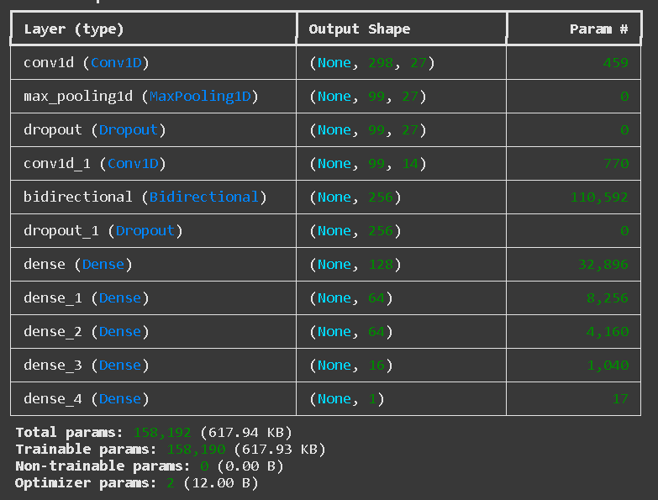
Promoter Prediction Model
CNN + GRU-based neural network.
Trained on labeled promoter vs. non-promoter sequences.
Achieved over 86% validation and test accuracy.
Input: One-hot encoded DNA, Output: Promoter likelihood.
Model Summary

Slide 14
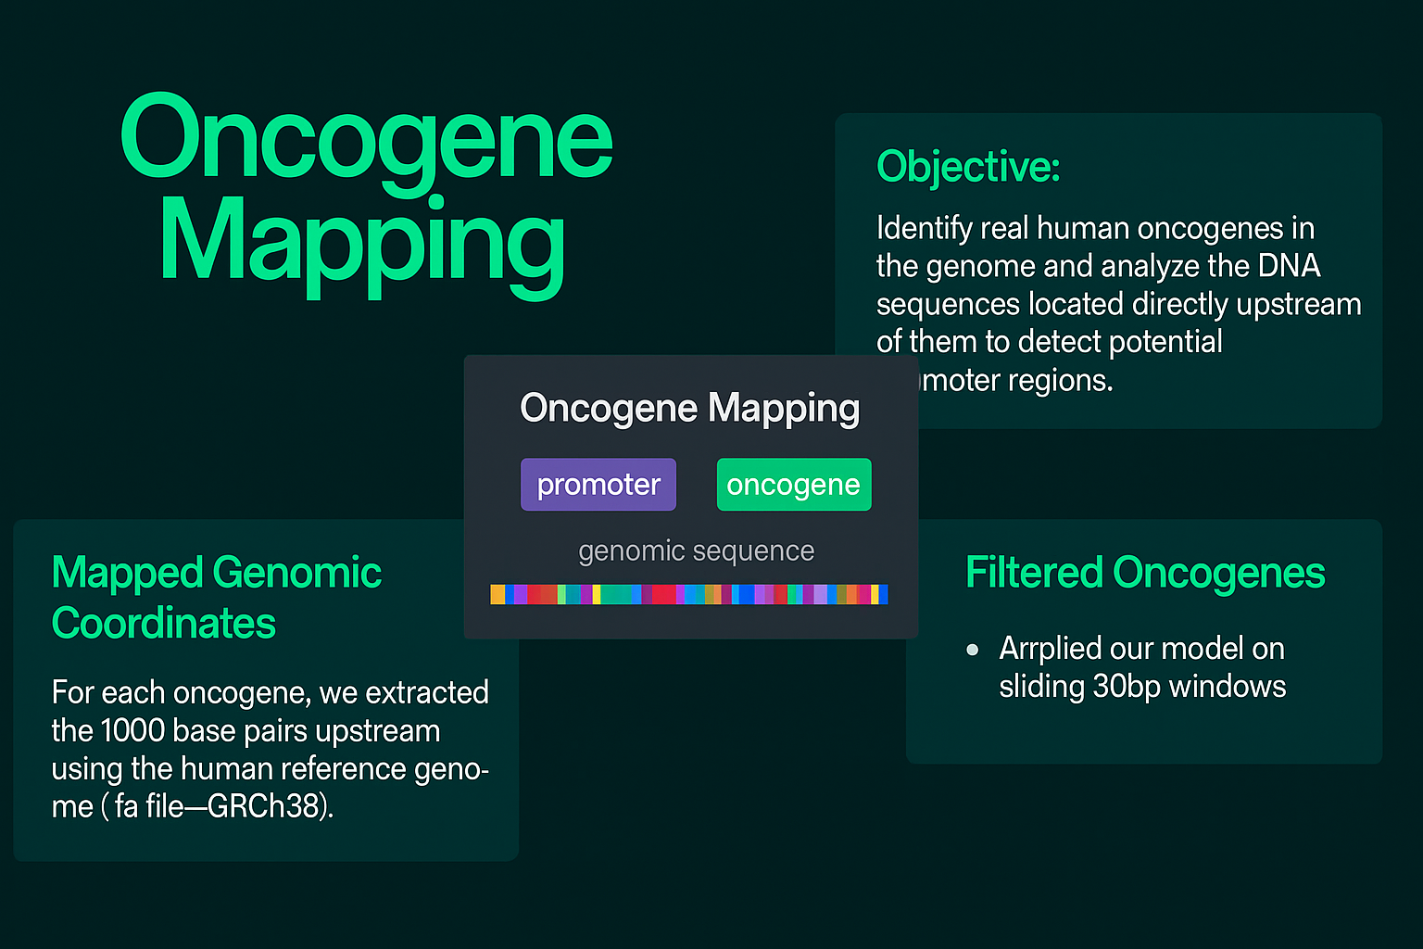

Slide 15
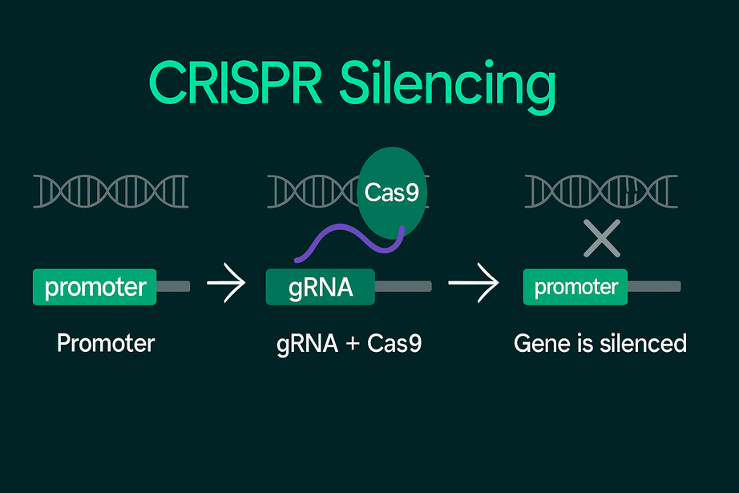
Objective:
CRISPR Silencing Simulation
To simulate how CRISPR can be used to silence oncogenes by targeting their upstream promoter regions.
Detect Promoter Sequences:
Our model identifies promoter regions with high confidence (>0.5) located upstream of known oncogenes.
Select Target Sites for CRISPR:
Simulate Gene Silencing:
Output:
Table of gRNA targets with:
Gene name
Chromosome & position
Predicted promoter probability
Simulated silencing outcome
We virtually "cut" these promoter regions using the CRISPR gRNAs, assuming loss of function will switch the oncogene OFF.
From each predicted promoter, we extract 20 bp sequences that represent potential guide RNA (gRNA) targets.

Slide 16
Results & Analysis

Slide 17
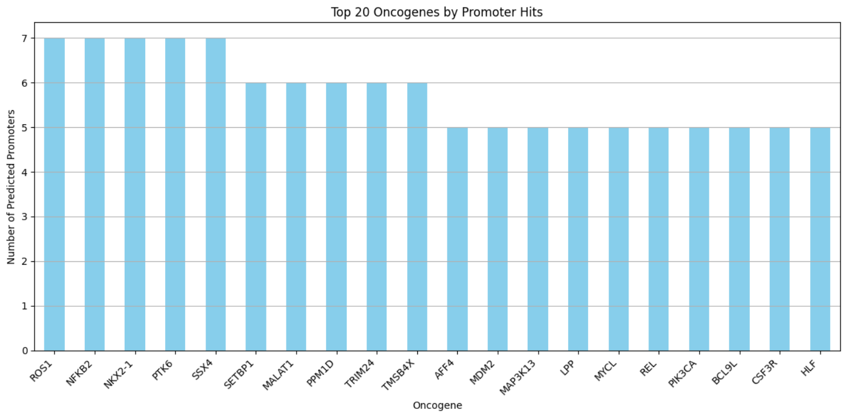

Slide 18
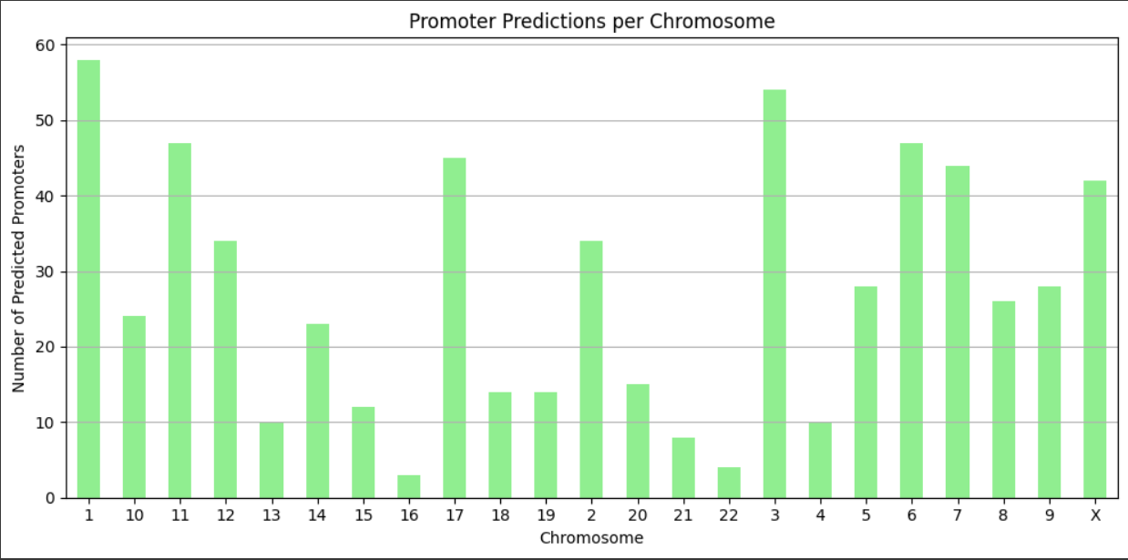

Slide 19
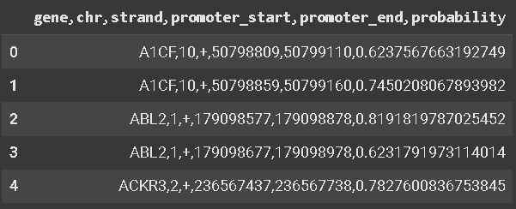
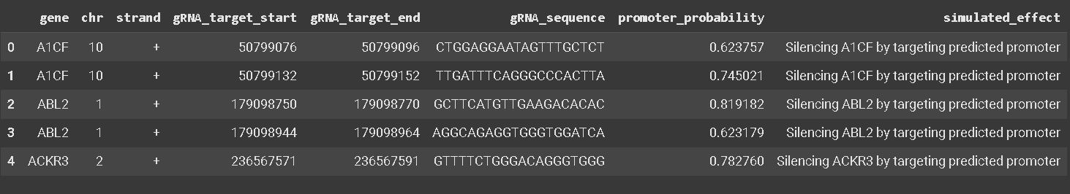
Promoters Oncogenes Mapping Predictions sample
Simulating CRISPR Silencing Results

Slide 20
Future Work

Slide 21

Future Work
Build on our Foundational Step in Cancer Gene Cerapy
Extend to tissue-specific promoters.
Integrate enhancer prediction.
Link to transcriptomics and methylation data.
Potential clinical validation.
Integrates with gene expression validation.

Slide 22


